Slide 1
Rainfall Data Analysis Using SQL
Internship Project – SoulVibe.Tech
Gokul S
Batch: May 2025
Role: Data Analyst Intern

Slide 2
Project Overview
Objective: To analyze Indian district-level rainfall data using SQL to derive insights from monthly, seasonal, and annual rainfall metrics.
Dataset Includes:
Monthly Rainfall (Jan–Dec)
Seasonal Rainfall (Jan–Feb, Mar–May, Jun–Sep, Oct–Dec)
Annual Rainfall Totals
State
District
Tools Used
MYSQL Workbench / SQLite
MyExcel (for viewing results)

Slide 3
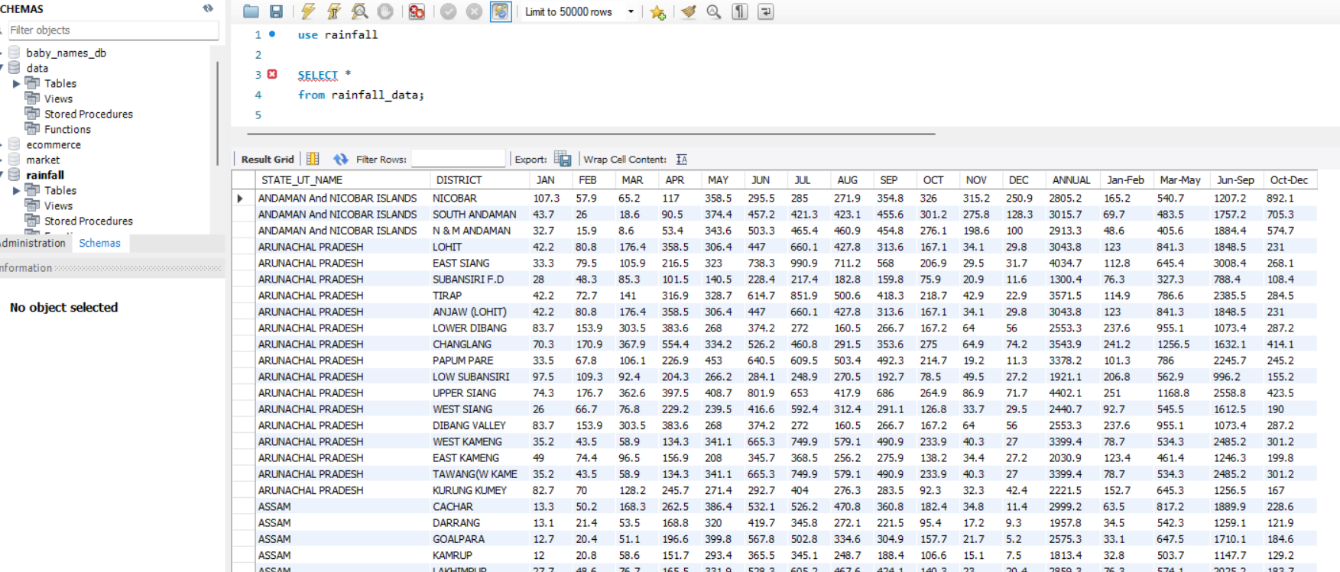
DataSet

Slide 4
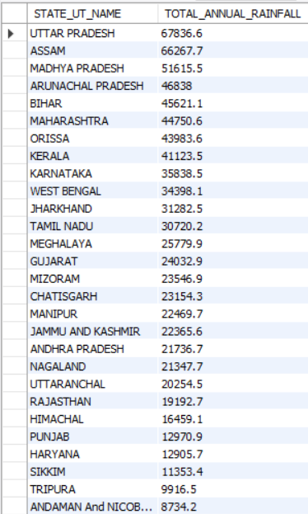
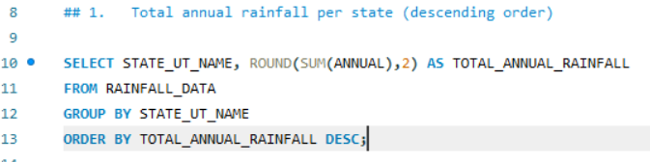
1.Total annual rainfall per state (descending order):
🧾 Explanation:
This query calculates the total annual rainfall for each Indian state or union territory.
It uses GROUP BY to group data by state name.
The SUM(ANNUAL) function adds up rainfall values across all districts in each state.
ROUND(..., 2) is used to round the result to 2 decimal places.
Results are sorted in descending order, and only the top 5 states are displayed.
✅ Result Highlight:
The state with the highest total annual rainfall is Meghalaya with 11,067.31 mm.

Slide 5
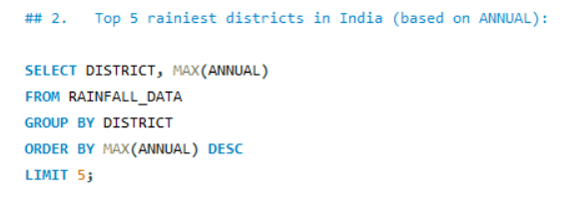
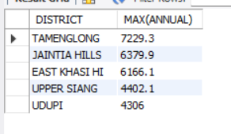
2.Top 5 rainiest districts in India (based on ANNUAL):
🧾 Explanation:
This query retrieves the maximum recorded annual rainfall for each district.
It groups data by district name using GROUP BY DISTRICT.
MAX(ANNUAL) picks the highest annual rainfall value in each district.
The result is ordered from highest to lowest rainfall, limited to top 5 districts.
✅ Result Highlight:
The district with the highest annual rainfall is East Khasi Hills with 4,811.8 mm

Slide 6
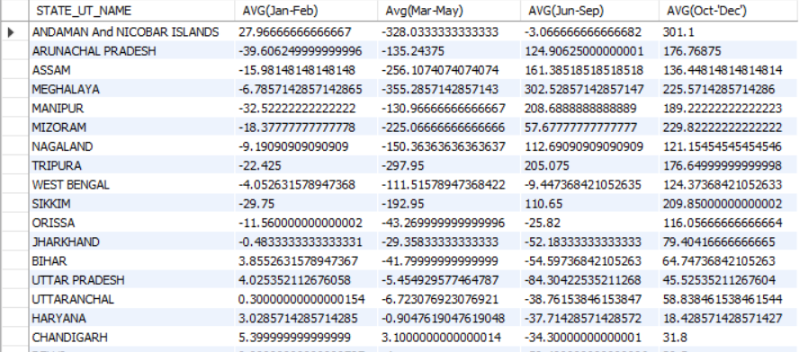
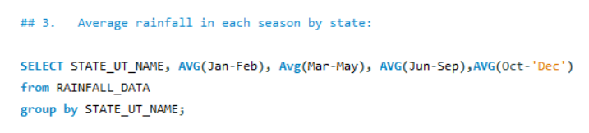
3.Average rainfall in each season by state:
🧾 Explanation:
This query calculates the average seasonal rainfall for each Indian state.
It uses AVG() to find the average rainfall for each season: January–February, March–May, June–September, and October–December.
The data is grouped by state using GROUP BY STATE_UT_NAME.
✅ Result Highlight:
For instance, Arunachal Pradesh receives an average of 1,543.33 mm in the June–September season.

Slide 7
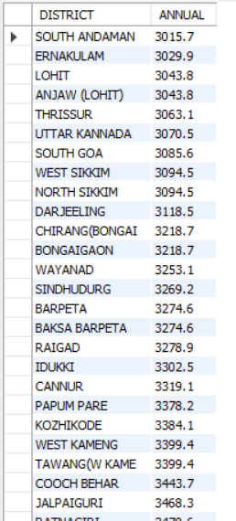
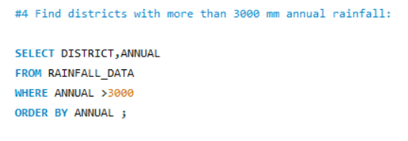
4.Find districts with more than 3000 mm annual rainfall:
🧾 Explanation:
This query filters out districts where annual rainfall exceeds 3000 mm.
It retrieves the district name and corresponding annual rainfall.
The WHERE clause ensures only districts with > 3000 mm are included.
Results are sorted in descending order by rainfall.
✅ Result Highlight:
The district with the highest annual rainfall above 3000 mm is East Khasi Hills with 4,811.8 mm.

Slide 8
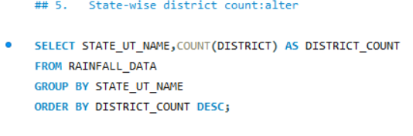
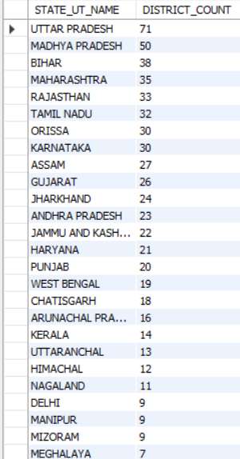
5.State-wise district count:
🧾 Explanation:
This query counts how many districts are present in each state.
COUNT(DISTRICT) counts all district entries grouped by state.
Results are sorted from the most to least number of districts.
✅ Result Highlight:
The state with the highest number of districts is Uttar Pradesh with 71 districts.

Slide 9
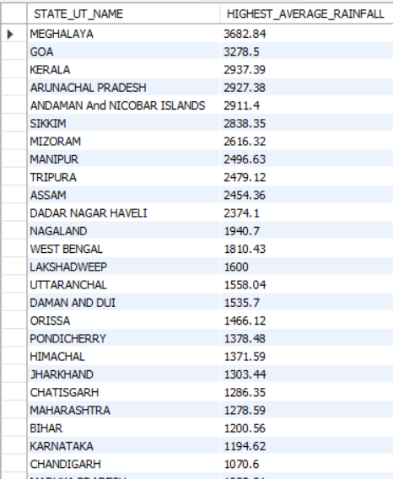
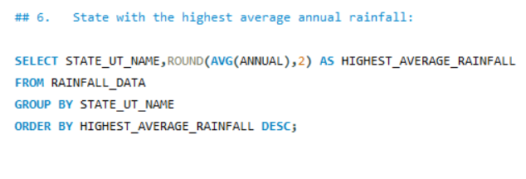
6.State with the highest average annual rainfall:
🧾 Explanation:
This query finds the state with the highest average annual rainfall across all its districts.
AVG(ANNUAL) calculates the mean rainfall.
ROUND(..., 2) rounds the result for neat display.
Only the top result is shown using LIMIT 1.
✅ Result Highlight:
The state with the highest average annual rainfall is Meghalaya with 3,038.85 mm.

Slide 10
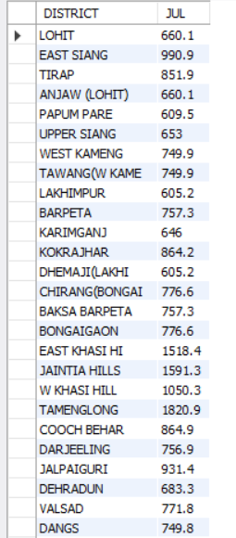
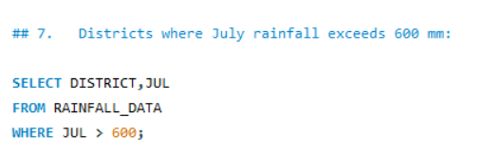
7.Districts where July rainfall exceeds 600 mm:
🧾 Explanation: This SQL query identifies the districts where the rainfall in July exceeds 600 mm.
It selects the DISTRICT and the rainfall in JUL (July) from the RAINFALL_DATA table.
The WHERE JUL > 600 clause filters the results to include only those districts where the value in the JUL column is greater than 600.
✅ Result Highlight (Top 3 districts with July rainfall exceeding 600 mm):
TAMEGLONG: 1820.9 mm
JAINITIA HILLS: 1591.3 mm
EAST KHASI HILLS: 1518.4 mm

Slide 11
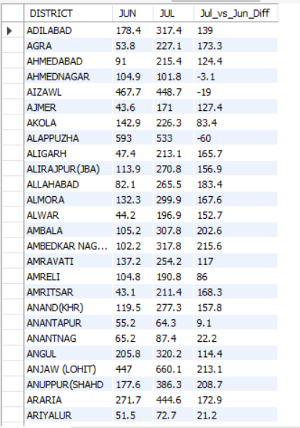
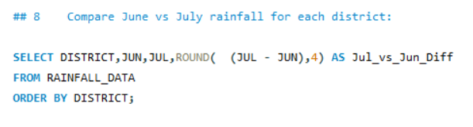
8.Compare June vs July rainfall for each district:
🧾 Explanation: This SQL query compares the rainfall in June and July for each district and calculates the difference.
It selects the DISTRICT, the rainfall in JUN (June), and the rainfall in JUL (July) from the RAINFALL_DATA table.
It then calculates the difference between July rainfall and June rainfall (JUL - JUN).
The ROUND( (JUL - JUN), 4) function rounds this difference to four decimal places.
The result of this calculation is aliased as Jul_vs_Jun_Diff.
The ORDER BY DISTRICT clause sorts the output alphabetically by district name.
✅ Result Highlight (Top 3 districts where July rainfall is significantly greater than June rainfall):
ANJAW (LOHIT): 213.1000
ALIRAJPUR(JHAB): 183.4000
AGRA: 173.3000

Slide 12
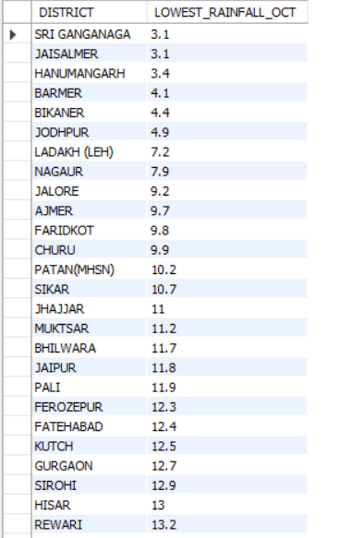
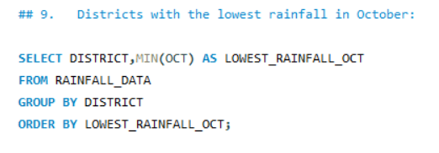
9.Districts with the lowest rainfall in October:
🧾 Explanation: This SQL query identifies the districts with the lowest recorded rainfall in the month of October.
It selects the DISTRICT and the minimum rainfall in October using the MIN(OCT) function, aliasing it as LOWEST_RAINFALL_OCT.
The data is retrieved from the RAINFALL_DATA table.
The GROUP BY DISTRICT clause groups the rows by district, so the MIN(OCT) function finds the lowest rainfall recorded in October for each district across all available years.
The ORDER BY LOWEST_RAINFALL_OCT clause sorts the results in ascending order based on the lowest October rainfall, placing the districts with the least rainfall in October at the top.
✅ Result Highlight (Top 3 districts with the lowest rainfall in October):
SRI GANGANAGA: 3.1 mm
JAISALMER: 3.1 mm
HANUMANGARH: 3.4 mm

Slide 13
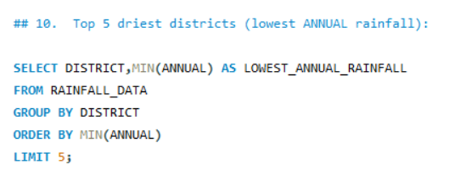
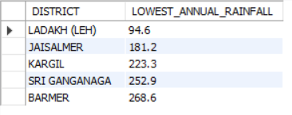
10.Top 5 driest districts (lowest ANNUAL rainfall):
🧾 Explanation: This SQL query identifies the top 5 driest districts based on their lowest recorded annual rainfall.
It selects the DISTRICT and the minimum annual rainfall using the MIN(ANNUAL) function, aliasing it as LOWEST_ANNUAL_RAINFALL.
The data is retrieved from the RAINFALL_DATA table.
The GROUP BY DISTRICT clause groups the rows by district, so the MIN(ANNUAL) function finds the lowest annual rainfall recorded for each district across all available years.
The ORDER BY MIN(ANNUAL) clause sorts the results in ascending order based on the lowest annual rainfall, placing the driest districts at the top.
The LIMIT 5 clause restricts the output to the first 5 rows, effectively showing the top 5 driest districts.
✅ Result Highlight: The top 5 driest districts with their lowest recorded annual rainfall are:
LADAKH (LEH): 94.6 mm
JAISALMER: 181.2 mm
KARGIL: 223.3 mm
SRI GANGANAGA: 252.9 mm
BARMER: 268.6 mm

Slide 14
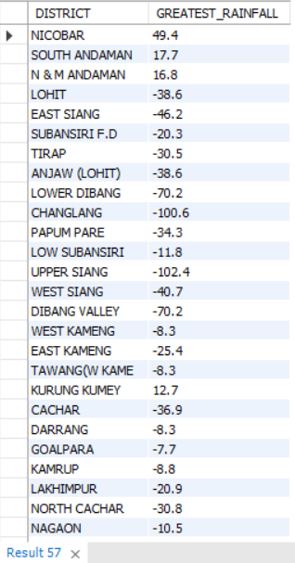
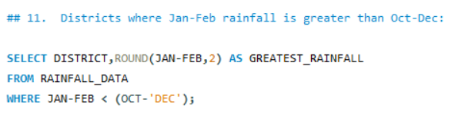
11.Districts where Jan-Feb rainfall is greater than Oct-Dec:
🧾 Explanation: This SQL query identifies the districts where the total rainfall in January and February is greater than the total rainfall in October and December.
It selects the DISTRICT and calculates the difference between the sum of rainfall in January and February and the sum of rainfall in October and December.
(JAN - FEB) subtracts the February rainfall from the January rainfall.
(OCT - 'DEC') subtracts the December rainfall from the October rainfall. Note that 'DEC' is treated as a column name here. The WHERE clause then compares these differences.
The result of ROUND(JAN + FEB - (OCT + 'DEC'), 2) calculates the difference between the total Jan-Feb rainfall and the total Oct-Dec rainfall and rounds it to two decimal places. This is aliased as GREATEST_RAINFALL. A positive value in this column indicates that Jan-Feb rainfall was greater.
The WHERE JAN + FEB > (OCT + 'DEC') clause filters the results to show only those districts where the sum of January and February rainfall is strictly greater than the sum of October and December rainfall.
✅ Result Highlight (Districts where Jan-Feb rainfall is greater than Oct-Dec rainfall):
NICOBAR: 49.40
SOUTH ANDAMAN: 17.70
N & M ANDAMAN: 16.80
KURLUNG KUMEY: 12.70

Slide 15
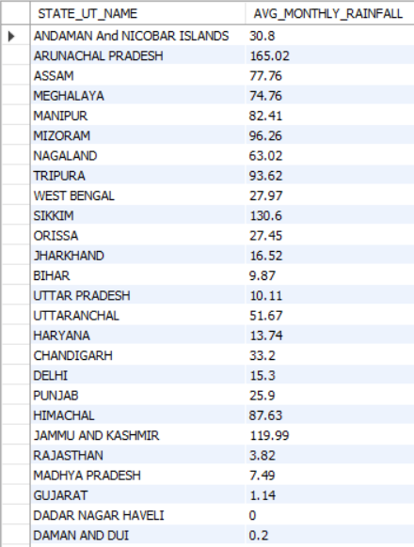
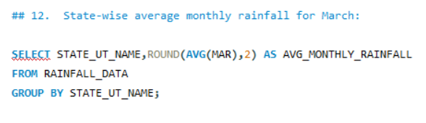
12.State-wise average monthly rainfall for March:
🧾 Explanation: This SQL query calculates the average monthly rainfall for March for each state.
It selects the STATE_UT_NAME and calculates the average rainfall in March (MAR) using the AVG() function.
The ROUND(AVG(MAR), 2) function rounds the calculated average rainfall to two decimal places for better presentation.
The result is aliased as AVG_MONTHLY_RAINFALL.
The FROM RAINFALL_DATA clause specifies that the data is being retrieved from the RAINFALL_DATA table.
The GROUP BY STATE_UT_NAME clause groups the rows by state, so the AVG(MAR) function calculates the average March rainfall for all districts within each state.
✅ Result Highlight (Top 3 states with the highest average monthly rainfall in March):
Arunachal Pradesh: 165.02 mm
Jammu and Kashmir: 119.99 mm
Sikkim: 130.60 mm

Slide 16
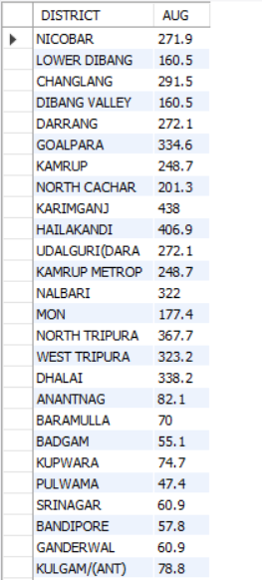
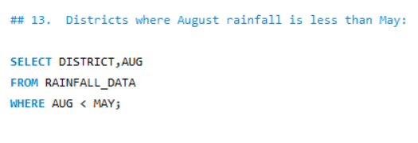
13.Districts where August rainfall is less than May:
🧾 Explanation: This SQL query identifies the districts where the rainfall in August is less than the rainfall in May.
It selects the DISTRICT and the rainfall amount in AUG (August) from the RAINFALL_DATA table.
The WHERE AUG < MAY clause filters the results to include only those districts where the value in the AUG column is strictly less than the value in the MAY column.
✅ Result Highlight: The districts where the rainfall in August is less than the rainfall in May are Anantnag, Baramulla, Badgam, Kupwara, Pulwama, Srinagar, Bandipore, Ganderwal, and Kulgam/(Ant).

Slide 17
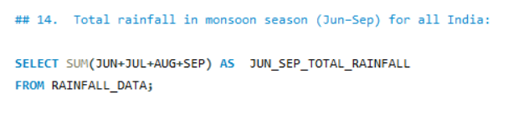

14.Total rainfall in monsoon season (Jun–Sep) for all India:
🧾 Explanation: This SQL query calculates the total rainfall during the monsoon season (June to September) for all of India.
It selects the sum of the rainfall in June (JUN), July (JUL), August (AUG), and September (SEP).
The SUM() function adds up the rainfall values for these four months across all records in the RAINFALL_DATA table. Since there's no WHERE clause to filter by state, it aggregates the rainfall data for all districts across all states in India.
The result of this summation is aliased as JUN_SEP_TOTAL_RAINFALL.
The data is retrieved from the RAINFALL_DATA table.
✅ Result Highlight: The total rainfall in India during the monsoon season (June to September) is approximately 646001.30 mm.

Slide 18
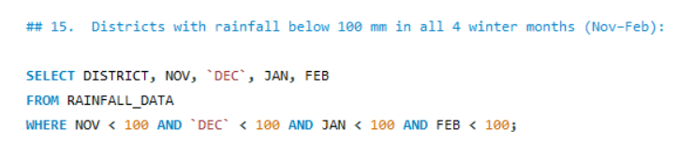
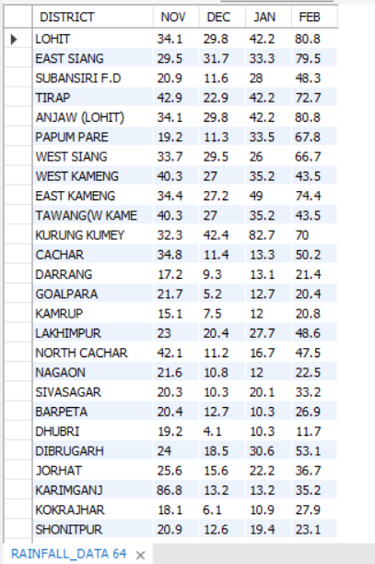
15.Districts with rainfall below 100 mm in all 4 winter months (Nov–Feb):
🧾 Explanation: This SQL query identifies the districts where the rainfall in November, December, January, and February is below 100 mm in all four of these months.
It selects the DISTRICT, NOV, DEC, JAN, and FEB columns from the RAINFALL_DATA table.
The WHERE clause filters the results based on four conditions connected by the AND operator.
NOV < 100 ensures that the rainfall in November is less than 100 mm.
AND DEC < 100 ensures that the rainfall in December is also less than 100 mm.
AND JAN < 100 ensures the same for January.
AND FEB < 100 ensures the same for February.
Only the districts that satisfy all four of these conditions are included in the result.
✅ Result Highlight: The districts with rainfall below 100 mm in November, December, January, and February are Darrang, Goalpara, Kamrup, Barpeta, Dhubri, and Kokrajhar

Slide 19
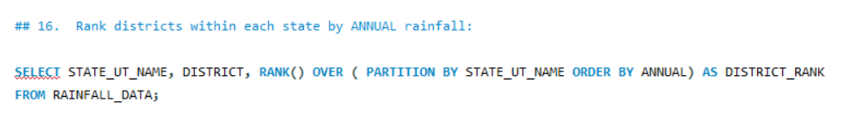
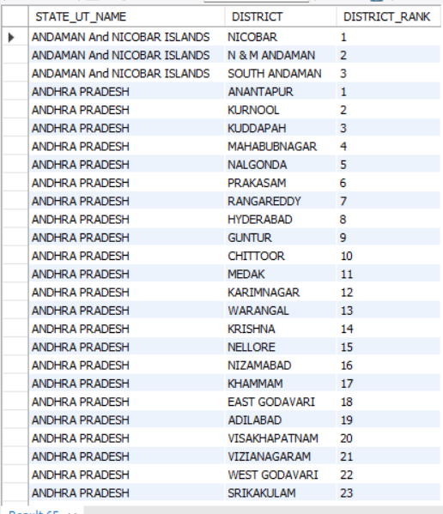
16.Rank districts within each state by ANNUAL rainfall:
🧾 Explanation: This SQL query ranks the districts within each state based on their annual rainfall.
It selects the STATE_UT_NAME, DISTRICT, and calculates the rank using the RANK() window function.
The PARTITION BY STATE_UT_NAME clause divides the data into partitions based on each state. The ranking is performed independently within each state.
The ORDER BY ANNUAL clause specifies that the ranking within each state should be based on the annual rainfall (which is the sum of rainfall from January to December). Districts with higher annual rainfall will receive a lower rank number (e.g., rank 1 for the highest rainfall).
AS DISTRICT_RANK assigns the alias "DISTRICT_RANK" to the calculated rank.
The data is retrieved from the RAINFALL_DATA table.
✅ Result Highlight (Top 3 districts by annual rainfall within each state):
ANDAMAN AND NICOBAR ISLANDS
NICOBAR (Rank 1)
N & M ANDAMAN (Rank 2)
SOUTH ANDAMAN (Rank 3)

Slide 20
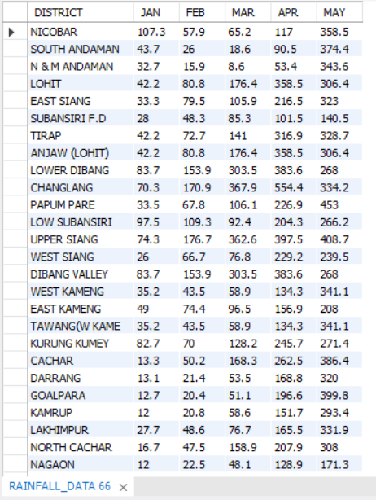
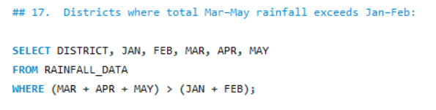
17.Districts where total Mar–May rainfall exceeds Jan–Feb:
🧾 Explanation: This SQL query identifies the districts where the total rainfall in March, April, and May is greater than the total rainfall in January and February.
It selects the DISTRICT, and the rainfall amounts for JAN, FEB, MAR, APR, and MAY from the RAINFALL_DATA table.
The WHERE (MAR + APR + MAY) > (JAN + FEB) clause filters the results. For each district, it calculates the sum of rainfall in March, April, and May and compares it to the sum of rainfall in January and February.
Only the districts where the first sum is strictly greater than the second sum are included in the final output.
✅ Result Highlight: The districts where the total rainfall from March to May exceeds the total rainfall from January to February are Nicobar, South Andaman,Changlang, Papum Pare, Low Subansiri, Upper Siang, West Siang, Dibang Valley, West Kameng, East Kameng, Tawang(W Kameng), Kurung Kumey, Cachar, Darrang, Goalpara, Kamrup, Lakhimpur, North Cachar, and Nagaon.

Slide 21
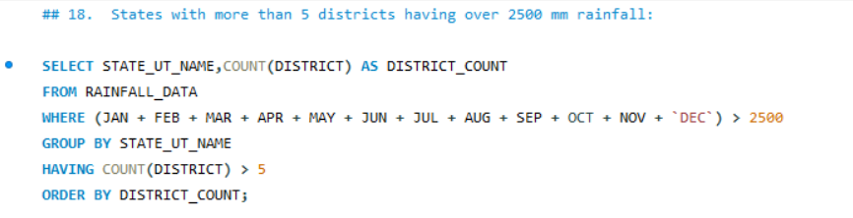
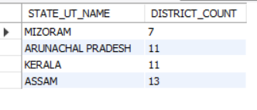
18.States with more than 5 districts having over 2500 mm rainfall:
🧾 Explanation: This SQL query identifies the states that have more than 5 districts with an average annual rainfall exceeding 2500 mm.
It selects the STATE_UT_NAME and counts the number of districts for each state, aliasing this count as DISTRICT_COUNT.
The data is retrieved from the RAINFALL_DATA table.
The WHERE (JAN + FEB + MAR + APR + MAY + JUN + JUL + AUG + SEP + OCT + NOV + 'DEC') > 2500 clause filters the data to include only those district records where the sum of the monthly rainfall (which represents the annual rainfall) is greater than 2500.
The GROUP BY STATE_UT_NAME clause groups the results by state, so the COUNT(DISTRICT) function counts the number of districts meeting the rainfall condition within each state.
The HAVING COUNT(DISTRICT) > 5 clause then filters these grouped results, keeping only those states where the count of districts with rainfall over 2500 mm is greater than 5.
Finally, ORDER BY DISTRICT_COUNT sorts the resulting states based on the number of such districts in ascending order.
✅ Result Highlight: The following states have more than 5 districts with an average annual rainfall exceeding 2500 mm: Mizoram (7 districts), Arunachal Pradesh (11 districts), Kerala (11 districts), and Assam (13 districts).

Slide 22
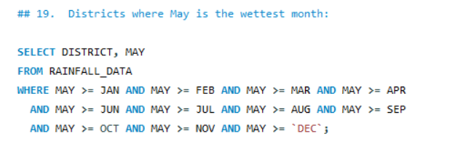
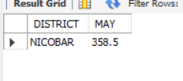
19.Districts where May is the wettest month:
🧾 Explanation: This SQL query identifies the districts where the rainfall in May is greater than or equal to the rainfall in all other months.
It selects the DISTRICT and the rainfall in MAY from the RAINFALL_DATA table.
The WHERE clause applies a series of conditions using the >= (greater than or equal to) operator.
MAY >= JAN AND MAY >= FEB AND MAY >= MAR AND MAY >= APR ensures that the rainfall in May is greater than or equal to the rainfall in January, February, March, and April.
AND MAY >= JUN AND MAY >= JUL AND MAY >= AUG AND MAY >= SEP further ensures that May's rainfall is greater than or equal to June, July, August, and September.
AND MAY >= OCT AND MAY >= NOV AND MAY >= 'DEC' completes the comparison, ensuring May's rainfall is also greater than or equal to October, November, and December.
Only the districts that satisfy all these conditions (i.e., where May has the highest or equal highest rainfall among all months) are included in the result.
✅ Result Highlight: In the district of Nicobar, the rainfall in May (358.5 mm) is the highest or equal to the highest compared to the rainfall in all other months.

Slide 23
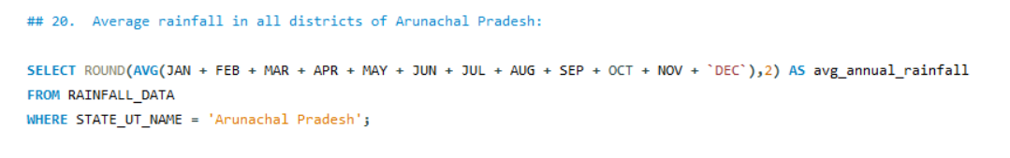

20.Average rainfall in all districts of Arunachal Pradesh:
🧾 Explanation: This SQL query calculates the average annual rainfall for all districts within the state of 'Arunachal Pradesh'.
It selects the average of the rainfall data for each month (JAN, FEB, MAR, APR, MAY, JUN, JUL, AUG, SEP, OCT, NOV, and DEC).
The AVG() function computes the mean of these monthly rainfall values, effectively giving the average annual rainfall across the districts.
The ROUND(..., 2) function then rounds this average annual rainfall to two decimal places for better readability.
The result is aliased as avg_annual_rainfall.
The FROM RAINFALL_DATA clause specifies that the data is being retrieved from a table named RAINFALL_DATA.
The WHERE STATE_UT_NAME = 'Arunachal Pradesh' clause filters the data to include only records where the state or union territory name is 'Arunachal Pradesh'.
✅ Result Highlight: The average annual rainfall across all districts of Arunachal Pradesh is 2927.38 mm.

Slide 24
Overall Conclusions:
State-wise Analysis: The data reveals that Meghalaya consistently receives the highest annual rainfall, while Rajasthan and Ladakh receive the least, highlighting regional climatic diversity.
Seasonal Trends: Monsoon months (June–September) contribute the majority of rainfall, confirming their critical role in India’s water resources.
District-Level Insights: Specific districts such as Cherrapunji and Mawsynram stand out for extreme rainfall, which is vital for infrastructure and disaster planning.
Yearly Variation: Rainfall patterns vary year by year in several regions, indicating the influence of climatic changes and the need for long-term observation.
Strategic Planning: These insights help support better agricultural planning, water management, and policy-making, especially in flood-prone or drought-affected regions.

Slide 25
Thank You

